Slide 1
CDE DE Fundamentals Assignment
By:
Akinbuwa Oluwadare.

Slide 2
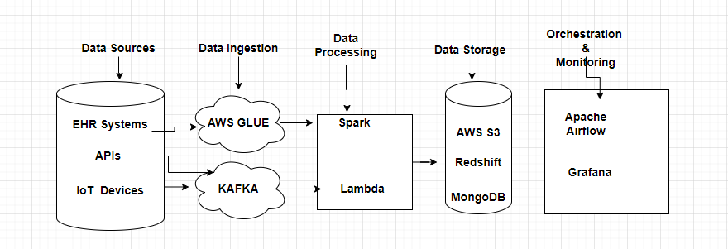
DATA PIPELINE

Slide 3
Task 1
Data sources like EHRs, IoT devices, and APIs are classified into structured, semi-structured, and unstructured data.
Batch processing ingestion method is selected for EHRs and periodic data from third-party APIs.
Real-time ingestion using tools like Apache Kafka or AWS Kinesis is chosen for streaming data from IoT devices and real-time API updates.
Data validation checks and failover mechanisms are planned to ensure data consistency and reliability.

Slide 4
Task 2
Data processing pipeline is defined with stages for cleaning, transforming, and enriching data.
Batch processing using Apache Spark is used for processing large datasets from EHRs.
Real-time processing using Apache Flink or AWS Lambda is employed for real-time data from IoT devices.
Data validation and quality checks are implemented at each stage to ensure data integrity.
The design is made scalable to handle varying data loads efficiently.

Slide 5
Task 3
A data lake (e.g., AWS S3) is chosen to store raw and semi-structured data from sources like IoT devices and APIs
A data warehouse (e.g., Amazon Redshift) is selected for storing structured, processed data from EHRs for efficient querying and analysis.
NoSQL databases (e.g., MongoDB, DynamoDB) are used for storing high-velocity, semi-structured data.
Partitioning, indexing, and data compression techniques are used to optimize storage performance.
Data encryption, role-based access control, and audit logging are implemented to ensure data security and compliance with regulations.

Slide 6
Task 4
Workflow management tools like Apache Airflow are used to automate and schedule data pipeline tasks.
Monitoring strategies include setting up metrics to track pipeline performance, and alerting mechanisms to detect failures.
Retry mechanisms and automated recovery processes are designed for handling task failures and ensuring pipeline reliability.
The orchestration framework is designed to scale with increasing data volumes and processing needs.
Logging and auditing are incorporated to support compliance and troubleshooting.

Slide 7
THANK YOU

